Slide 1
Aerospace Symposium 2021
Composites Radius Inspection – Calibration and defect sizing
Tom Bertenshaw – Senior NDT Research Engineer
Thursday 22nd April 2021
Uncontrolled data - The documents within this transmission contain NO technical data subject to the "UK Export Control Act 2002 or EU Dual-Use Regulation (Council Regulation (EC) No 428/2009), as amended"

Slide 2
Aerospace Symposium 2021
Composites Radius Inspection – Calibration and defect sizing
The presentation covers:
The applicable specifications
The parameters evaluated
A brief description of a few radius inspection techniques
Proposed blocks to evaluate the parameters
Methods to size defects
Export Classification - NSR

Slide 3
Aerospace Symposium 2021
Composites Radius Inspection – Calibration and defect sizing
Inspection Composite components with phased array UT is commonplace in the industry.
This has led to best practises for equipment testing, characterisation and annual calibration. Specifications include:
BS EN ISO 18563-1:2015 - Non-destructive testing – Characterization and verification of ultrasonic phased array equipment. Part 1: Instruments
BS EN ISO 18563-2:2017 - Non-destructive testing – Characterization and verification of ultrasonic phased array equipment. Part 2: Probes
BS EN ISO 18563-3:2015 - Non-destructive testing – Characterization and verification of ultrasonic phased array equipment. Part 3: Combined Equipment
ASTM E317: Evaluating performance characteristics of Ultrasonic Pulse-echo Testing Instruments and Systems with the use of electronic measurement systems
Export Classification - NSR

Slide 4
Aerospace Symposium 2021
Composites Radius Inspection – Calibration and defect sizing
Types of Composite radius inspection
Parameters subject to evaluation (not necessarily aligned with specs shown on previous page)
Category | Parameter
Probe | Spectrum & Bandwidth
 | Pulse shape
 | Sensitivity
Instruments | Pulser
 | Frequency response
 | Accuracy of calibrated attenuator/gain control
 | Vertical linearity
Combined equipment | Resolution
 | Sensitivity and noise
 | Backlash
 | Sizing of defects
 | Overlapping
 | Normalisation
Subject to deviation from current requirements due to radius geometry
Radius Tan-line to tan-line coverage using curved array probe and water box
Radius tan line to tan-line coverage using flat array probe utilising solid wedge and beam steering
Radius Tan-line to tan-line coverage using curved array probe
partial radius coverage
using curved array probe
partial radius coverage
using flat array probe
Export Classification - NSR

Slide 5
Aerospace Symposium 2021
Composites Radius Inspection – Calibration of parameters
The spectrum & bandwidth, pulse shape and sensitivity are evaluated using the same “half pipe” cal block
Note: the radius of the calibration block must match that of the radius probe
Probe
Rexolite ®
calibration
block
Export Classification - NSR

Slide 6
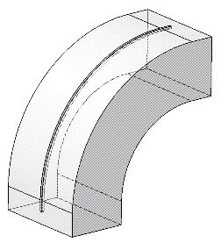
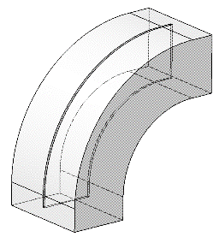
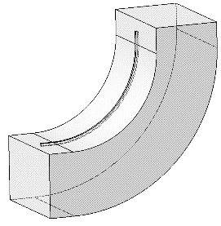
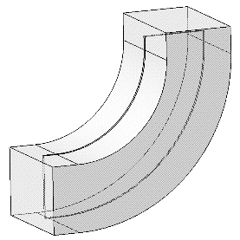
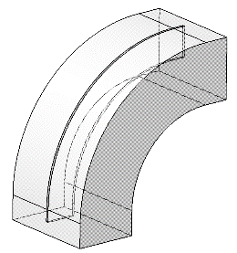
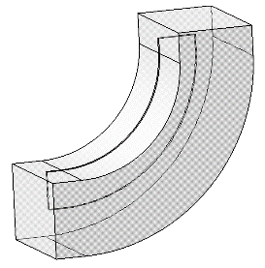
Aerospace Symposium 2021
Composites Radius Inspection – Calibration of parameters
Note: the radius of the calibration block (R₁) must match that of the radius probe
A number of blocks are proposed here.
For vertical linearity
To calibrate resolution and sensitivity, the whole system must be considered. Therefore the probe is evaluated with the instrument (and shoe where relevant)
Probe
R₁
¾ R₁
Rexolite ®
calibration
block
Internal radii:
External radii:
Internal radius sensitivity block
External radius sensitivity block
Far surface resolution block
Entry surface resolution block
Entry surface resolution block
Far surface resolution block
Export Classification - NSR

Slide 7
Aerospace Symposium 2021
Composites Radius Inspection – Calibration of parameters
Overlap region subject to backlash
Backlash and overlapping
Normalisation
Defect Sizing
Angled faces of the saw tooth profile
Straight edge perpendicular to direction of inspection
45°
For defect measurement in radii, there are two methods proposed:
sizing by comparison to reference standard
sizing by geometrical calculation
Section A-A
External radius surface
A
5mm typ.
A
Internal radius surface
Export Classification - NSR

Slide 8
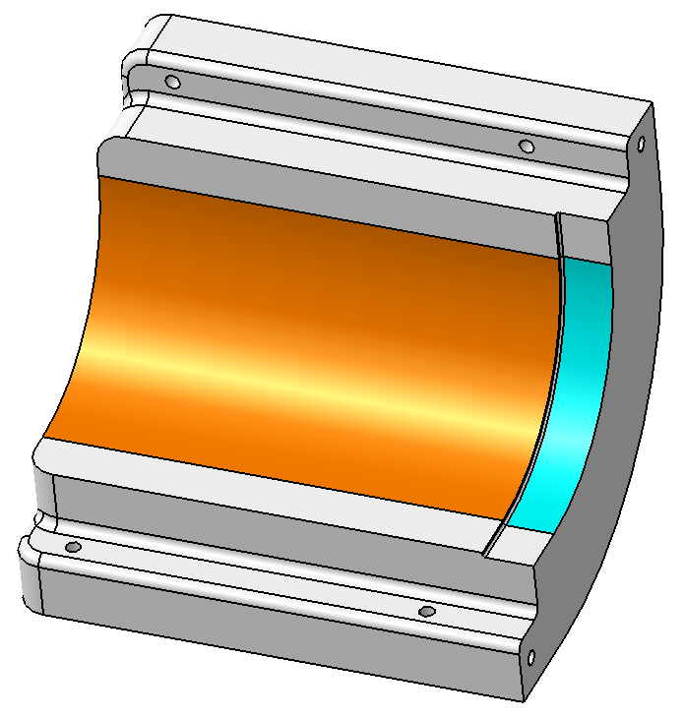
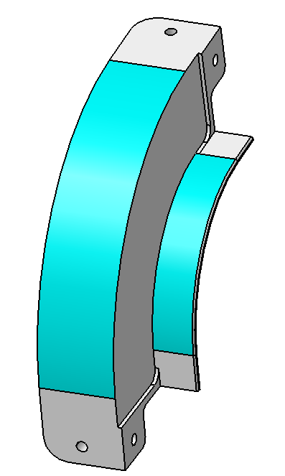
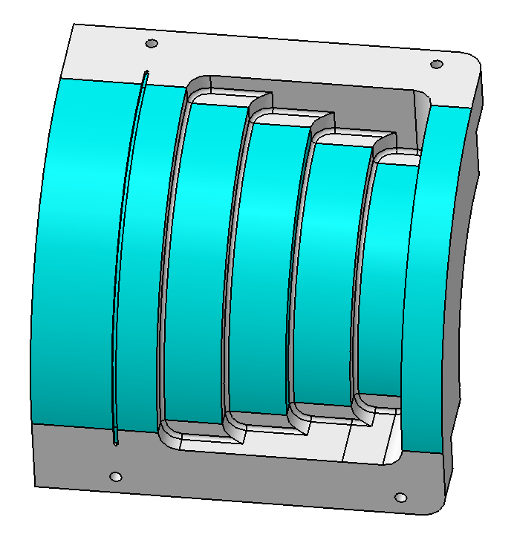
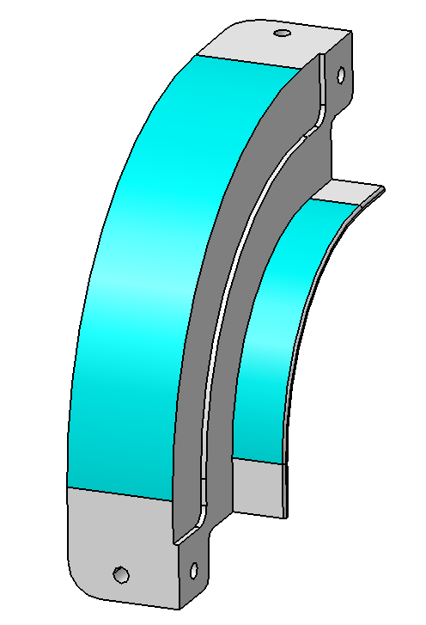
Aerospace Symposium 2021
Composites Radius Inspection – Calibration of parameters: example
Internal radius inspection at a GKN site
Rexolite® block designed in this case for Normalisation, Sensitivity and Resolution
Interface surface resolution block
Normalisation and far surface resolution block
Sensitivity block
Export Classification - NSR

Slide 9
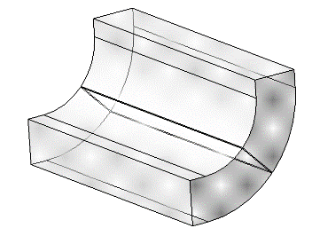
Aerospace Symposium 2021
Composites Radius Inspection – Defect sizing by comparison to reference standard
This requires a reference standard to have a number of defects placed through the thickness of the laminate
This example can be used for internal and external radii
Inserted defects only – no flat bottomed hole defects
Sizing the defect is a scaling task. This can be done by the following steps:
measured on the part and the depth of the defect recorded
The defect on the reference standard or reference sample is found with a corresponding depth (or as close a possible) and the artificial defect is measured
The defect (y_{actual}) can then be calculated
6x6mm PTFE (or similar) insert defects are spaced through the laminate
Aperture direction
$$y_{actual}=\frac{y_{part }×6}{y_{ref stnd}}$$
Where:
y_{part} = the measured defect on the part in the aperture direction
y_{ref stnd} = the measured defect on the reference standard in the aperture direction
Export Classification - NSR

Slide 10
Aerospace Symposium 2021
Composites Radius Inspection – Defect sizing by geometrical calculation
For internal radii, a defect is calculated by two factors:
Ratio of arc lengths of the probe and the part
Beam spread due to the changing radius size as the ultrasound progresses through the part
A_{P}
A_{P}
A₁
R₁
R₁
A₁
r_{P} – Radius of Probe
r₁ – Internal radius of part
r_{P} – Radius of Probe
r₁ – Internal radius of part
A_{P} – Arc length of probe active area
A₁ – Arc length of internal radius
r_{P}
Where:
d - defect size (6mm in this case, or measured defect)
r₁ – Radius of part or distance to front surface / interface
r₂ - defect depth (Rdef)
d₂ – scaled defect (from beam spread)
r₂
$$arc length (A)=\frac{θ}{360} ×2πr$$
r₁
d
$$d_{2}=\frac{\left.d{\left(r\right.}_{1}+r_{2}\right)}{r_{1}}$$
d₂
α
r₁
r₂
6mm defect (in red)
Export Classification - NSR

Slide 11
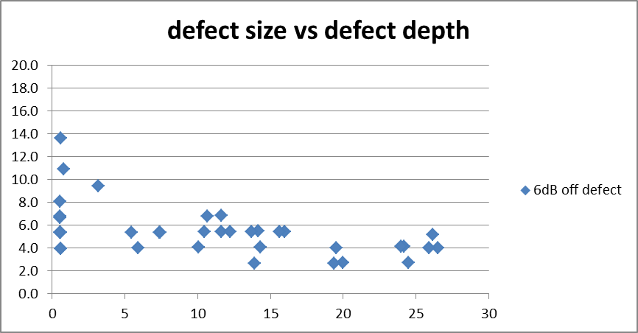
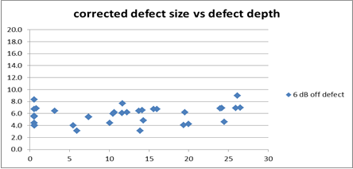
Aerospace Symposium 2021
Composites Radius Inspection – Applying calculations
This example shows the measurement of the defects in the active aperture direction before & after in a reference standard.
C-scan
Active aperture direction
Arc length = 56.5mm
Arc length = 45.5mm
Arc length = 33.6mm
Area covered from IML surface
Although there is an improvement, ±2mm is not really good enough.
Export Classification - NSR

Slide 12
Aerospace Symposium 2021
Composites Radius Inspection – Summary
A number of test blocks are proposed for the calibration of a number phased array radius inspection techniques
Proposals for the calculation of defect size for internal radius inspection has been made
Ongoing work: Calculation of defect size for external radius inspection
Export Classification - NSR

